Slide 1

Disney World
Analyzing the Influence of Weather on Waiting Times @
By: Vinh Tran

Slide 2
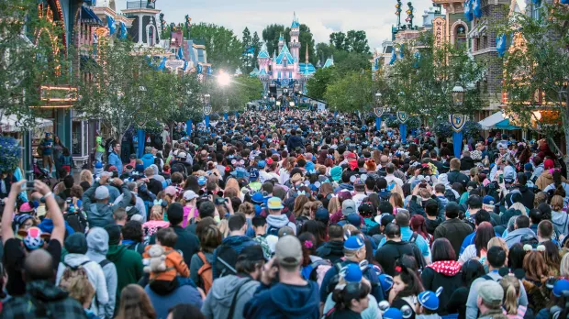
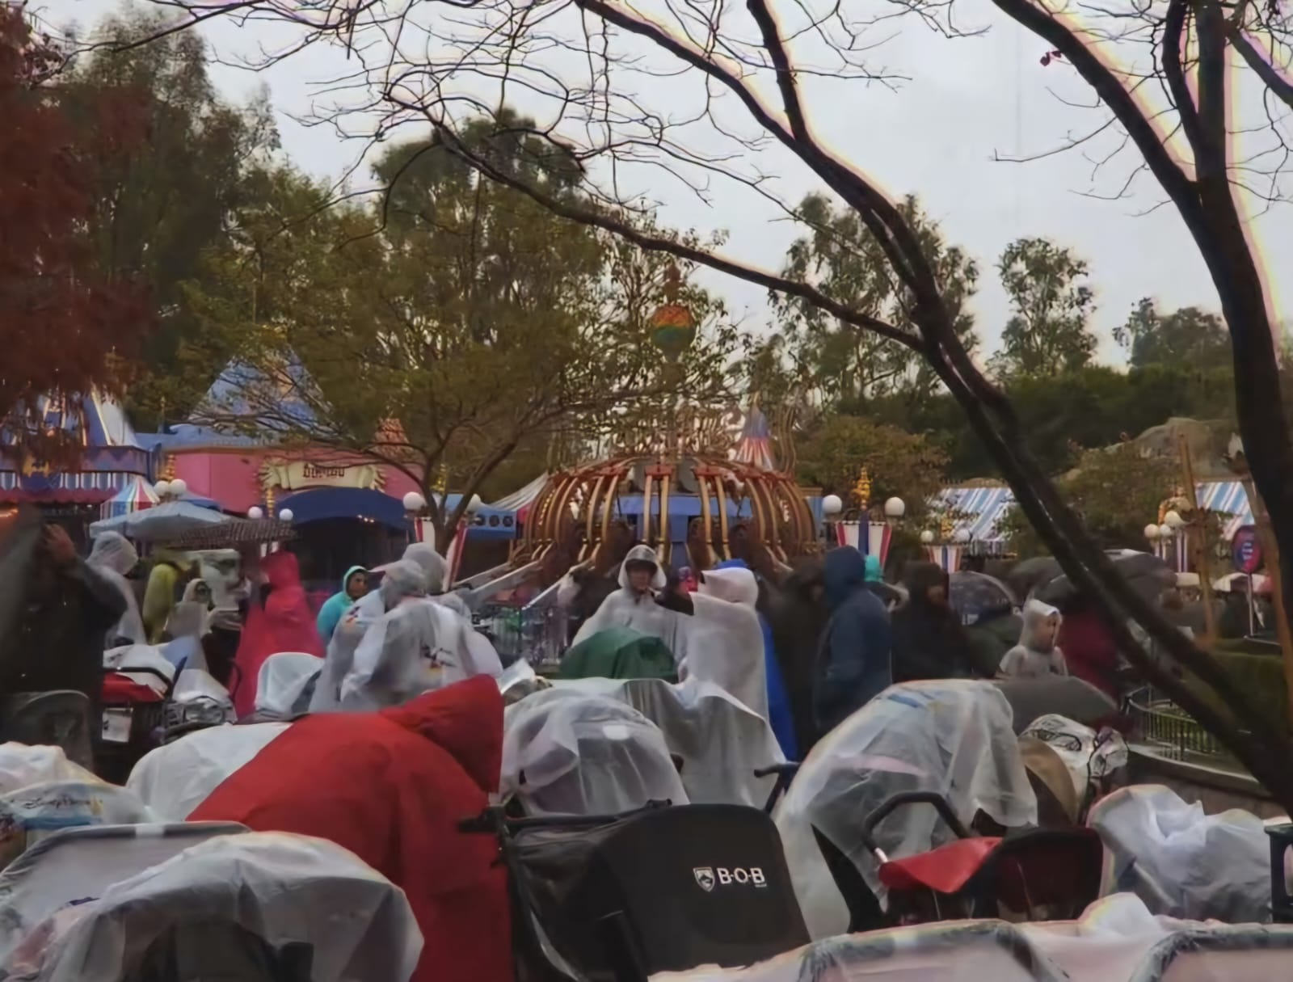
Introduction & Purpose
Plan to analyze weather data and the impact
Develop an understanding on how weather can crucially influence visitor behavior and crowd flow
Benefits the Park Management on making informed decisions
Enhance operational efficiency and resource allocation within Disney World.

Slide 3
Background Info
Background
Disney World, located in Orlando, Florida, is one of the world's most popular tourist destinations. With its array of attractions and diverse visitor demographics, managing waiting times is crucial for providing an enjoyable experience to guests.
Data
Primary data focuses on waiting times for different popular attractions/rides at Walt Disney World (WDW) in Orlando, Florida.
Collected from “touringplans.com” from 2012 to 2022 across 13 different rides over 17 seasons.
Secondary data focuses on the different weather conditions at the park by the hour per day.
NOTE: There will be snow condition data due to WDW releasing fake snow for events.
Relevance
Weather conditions, such as temperature, precipitation, and weather type/description, have the potential to influence visitor behavior and crowd flow within the park. Understanding this relationship is essential for optimizing operational efficiency and enhancing guest satisfaction.

Slide 4

Research Questions and Objective
How do different weather conditions (e.g., sunny, rainy, hot, cold) correlate with variations in waiting times at Disneyland attractions?
How do the main weather conditions affect downtimes in rides/attractions?
What is the average wait times of each attraction/ride by the hour compared to the temperature by the hour?
Objective: Investigate the relationship between weather conditions and waiting times/ride downtimes, leveraging historical data and weather patterns to uncover insights that can inform operational strategies within the park.

Slide 5

Cleaning Wait Times Data
Primary dataset had minor changes
Renaming of columns for easier merging
Sort data in chronological order by date and then time
Filter by specific dates
Could only filter up to a year due to the size of the dataset when merged with over 3.5 million rows
Narrowed down to 766,062 rows

Slide 6
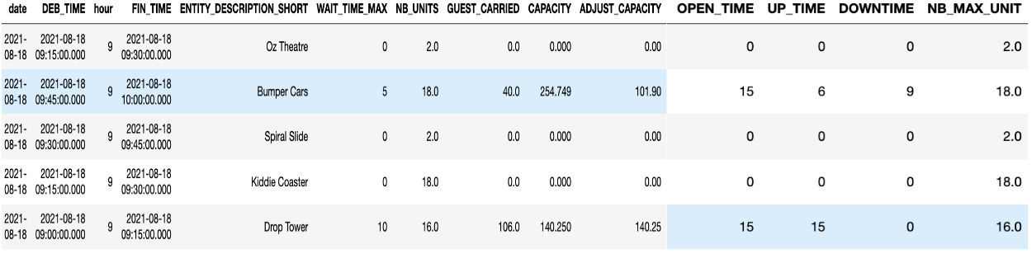
Cleaned Wait Times Data

Slide 7
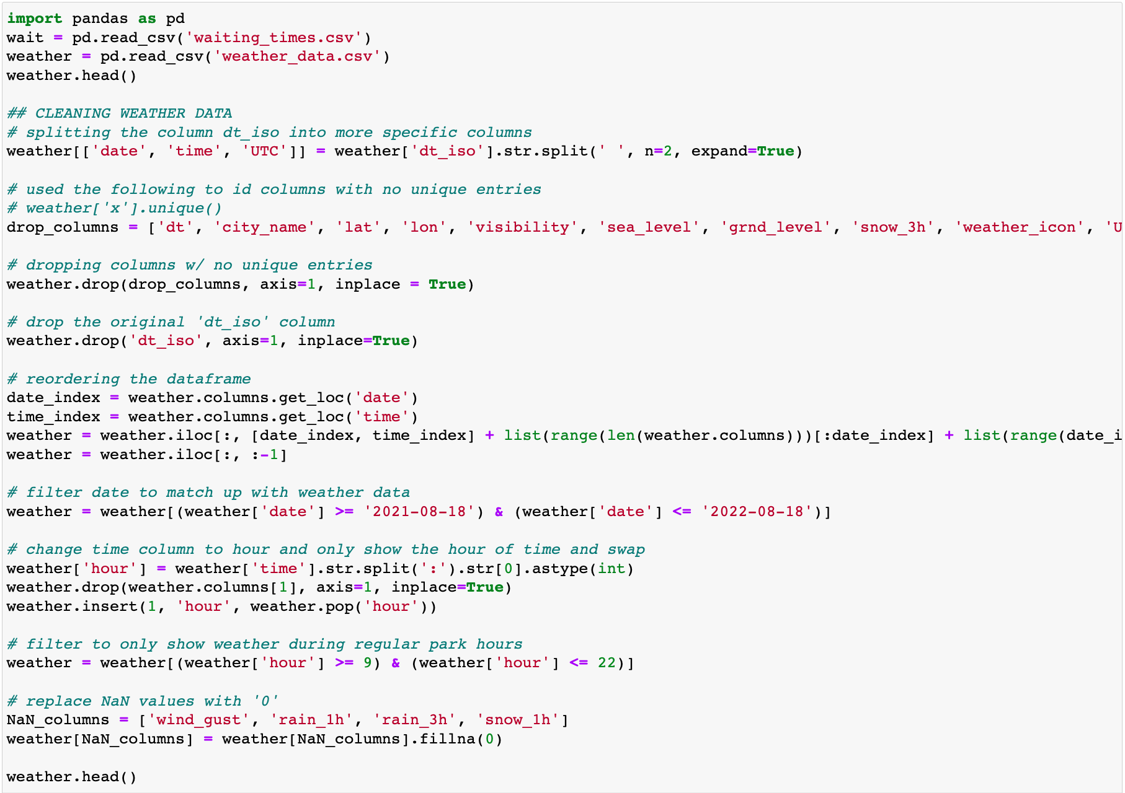
Cleaning the Weather Data
Identified columns with no unique values to remove
Split columns to get more specific values
Also easier to merge
Reordering the dataframe
Filter dates
Change column names for ease of merging
Find and replace null values with 0’s as for some weather conditions it makes sense to have none for that particular time.

Slide 8
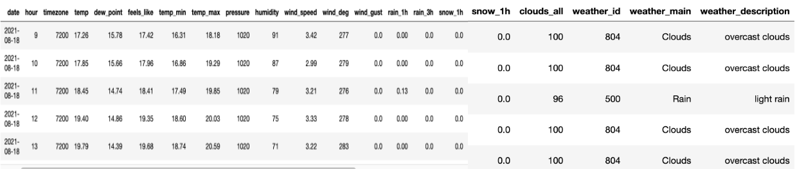
Cleaned Weather Data

Slide 9
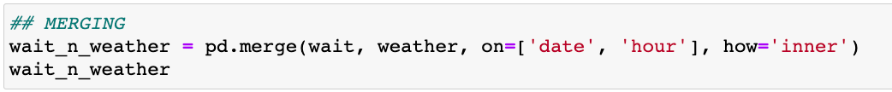
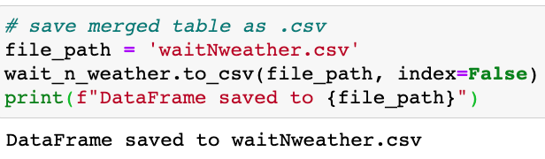
Merging and Saving to CSV file

Slide 10
Findings

Slide 11
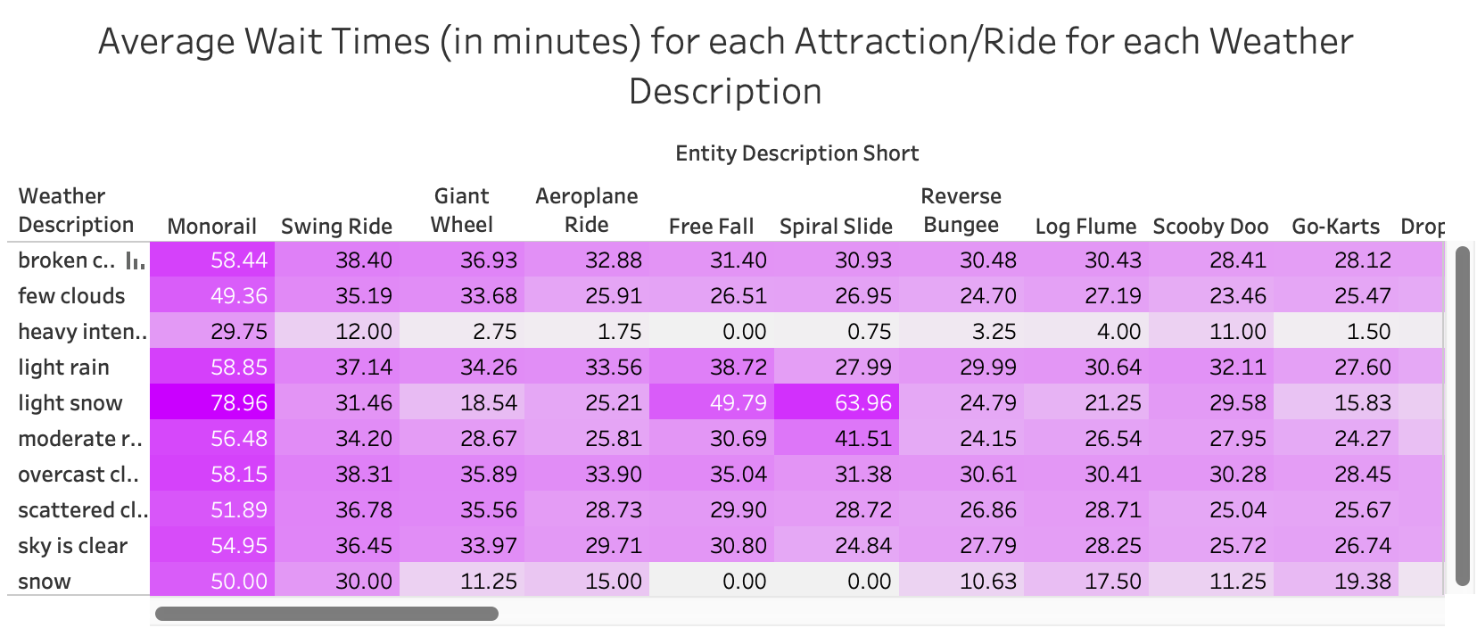
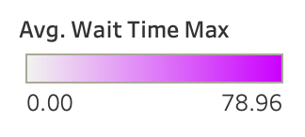
Key Inquiry 1: Analysis
Addresses the inquiry of the impact of different specific weather conditions on waiting times at WDW.
Generally the weather conditions “overcast clouds” and “light rain” have more impact on the wait times across the board.
“Monorail” is most affected by all weather conditions and the rides “Himalaya Ride” and “Top Spin” are the least affected.

Slide 12
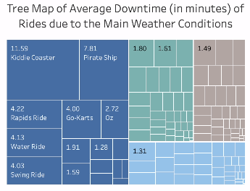
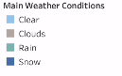
Key Inquiry 2: Analysis
Addresses the impact of general weather conditions on downtimes of rides and attractions inquiry.
Snow has much more of an effect on downtimes in rides/attractions.

Slide 13
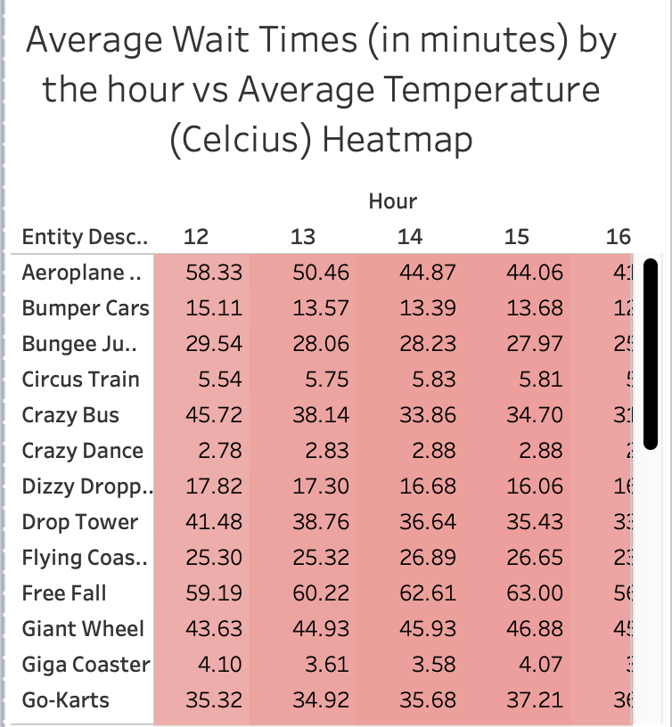
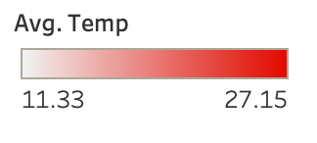
Key Inquiry 3: Analysis
Addresses our last inquiry, how does the average wait times of each ride/attraction compare to the temperature by the hour.
Hour by hour, we can see that the average temperature at the park gets hotter and hotter until hour 13 and then starts cooling off.
Also see the same trend with average wait times peaking at around hour 13 and then decreasing throughout the day.

Slide 14
Recommendations
When there are overcast clouds and light rain, WDW can expect in increase in average wait times for all rides and attractions, most of all, the Monorail.
Can provide coverage for customers waiting in line outside.
When there are snow and rain conditions, increase maintenance staff to decrease downtimes for all rides/attractions.
More maintenance staff can get rides up and going sooner, decreasing wait times
WDW can expect higher average wait times at around hour 12-14 of the day along with higher temperatures.
Can add refreshment stations to improve customer experience

Slide 15
Thank you!

